Slide 1
Reconfiguration-friendly Byzantine Fault-tolerant Distributed randomness
0xf5
0x00
Adithya Bhat
Notes:
Hello everyone, I am Adithya Bhat, and I will be talking about building random beacon protocols using the SMR protocol described by Nibesh.

Slide 2
Protocols for Randomness
A coin-toss protocol is a protocol between parties to generate a random number
A random beacon protocol is a protocol between servers to generate a sequence of random numbers for external clients
Both protocols have a requirement that the generated outputs are random
Example definition: Given a uniformly random string and the outputs of a randomness protocol, no PPT adversary can distinguish the outputs
A coin-toss is like Byzantine Agreement, a single shot protocol
A random beacon is like a blockchain, iterative and can be pipelined

Slide 3
Applications
A coin-toss protocol can be used to agree on something
who does the dishes
who goes first in a contest/sports
Zero knowledge protocols, 2-party MPC
A random beacon protocol is used when continuous service is required
Lotteries and Casinos
Proof-of-Stake systems, Asynchronous agreement (due to FLP)
MPC

Slide 4
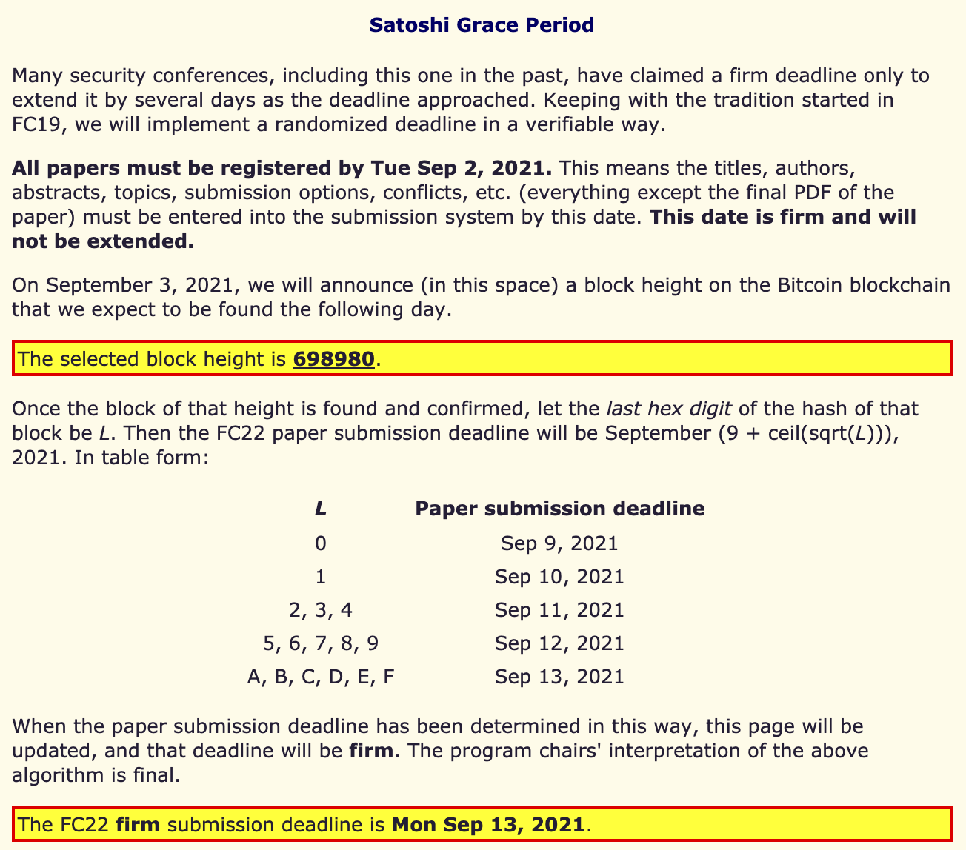
Motivation
Coin Toss or
Random Beacon?
Beacon Protocol as a Coin-Toss

Slide 5
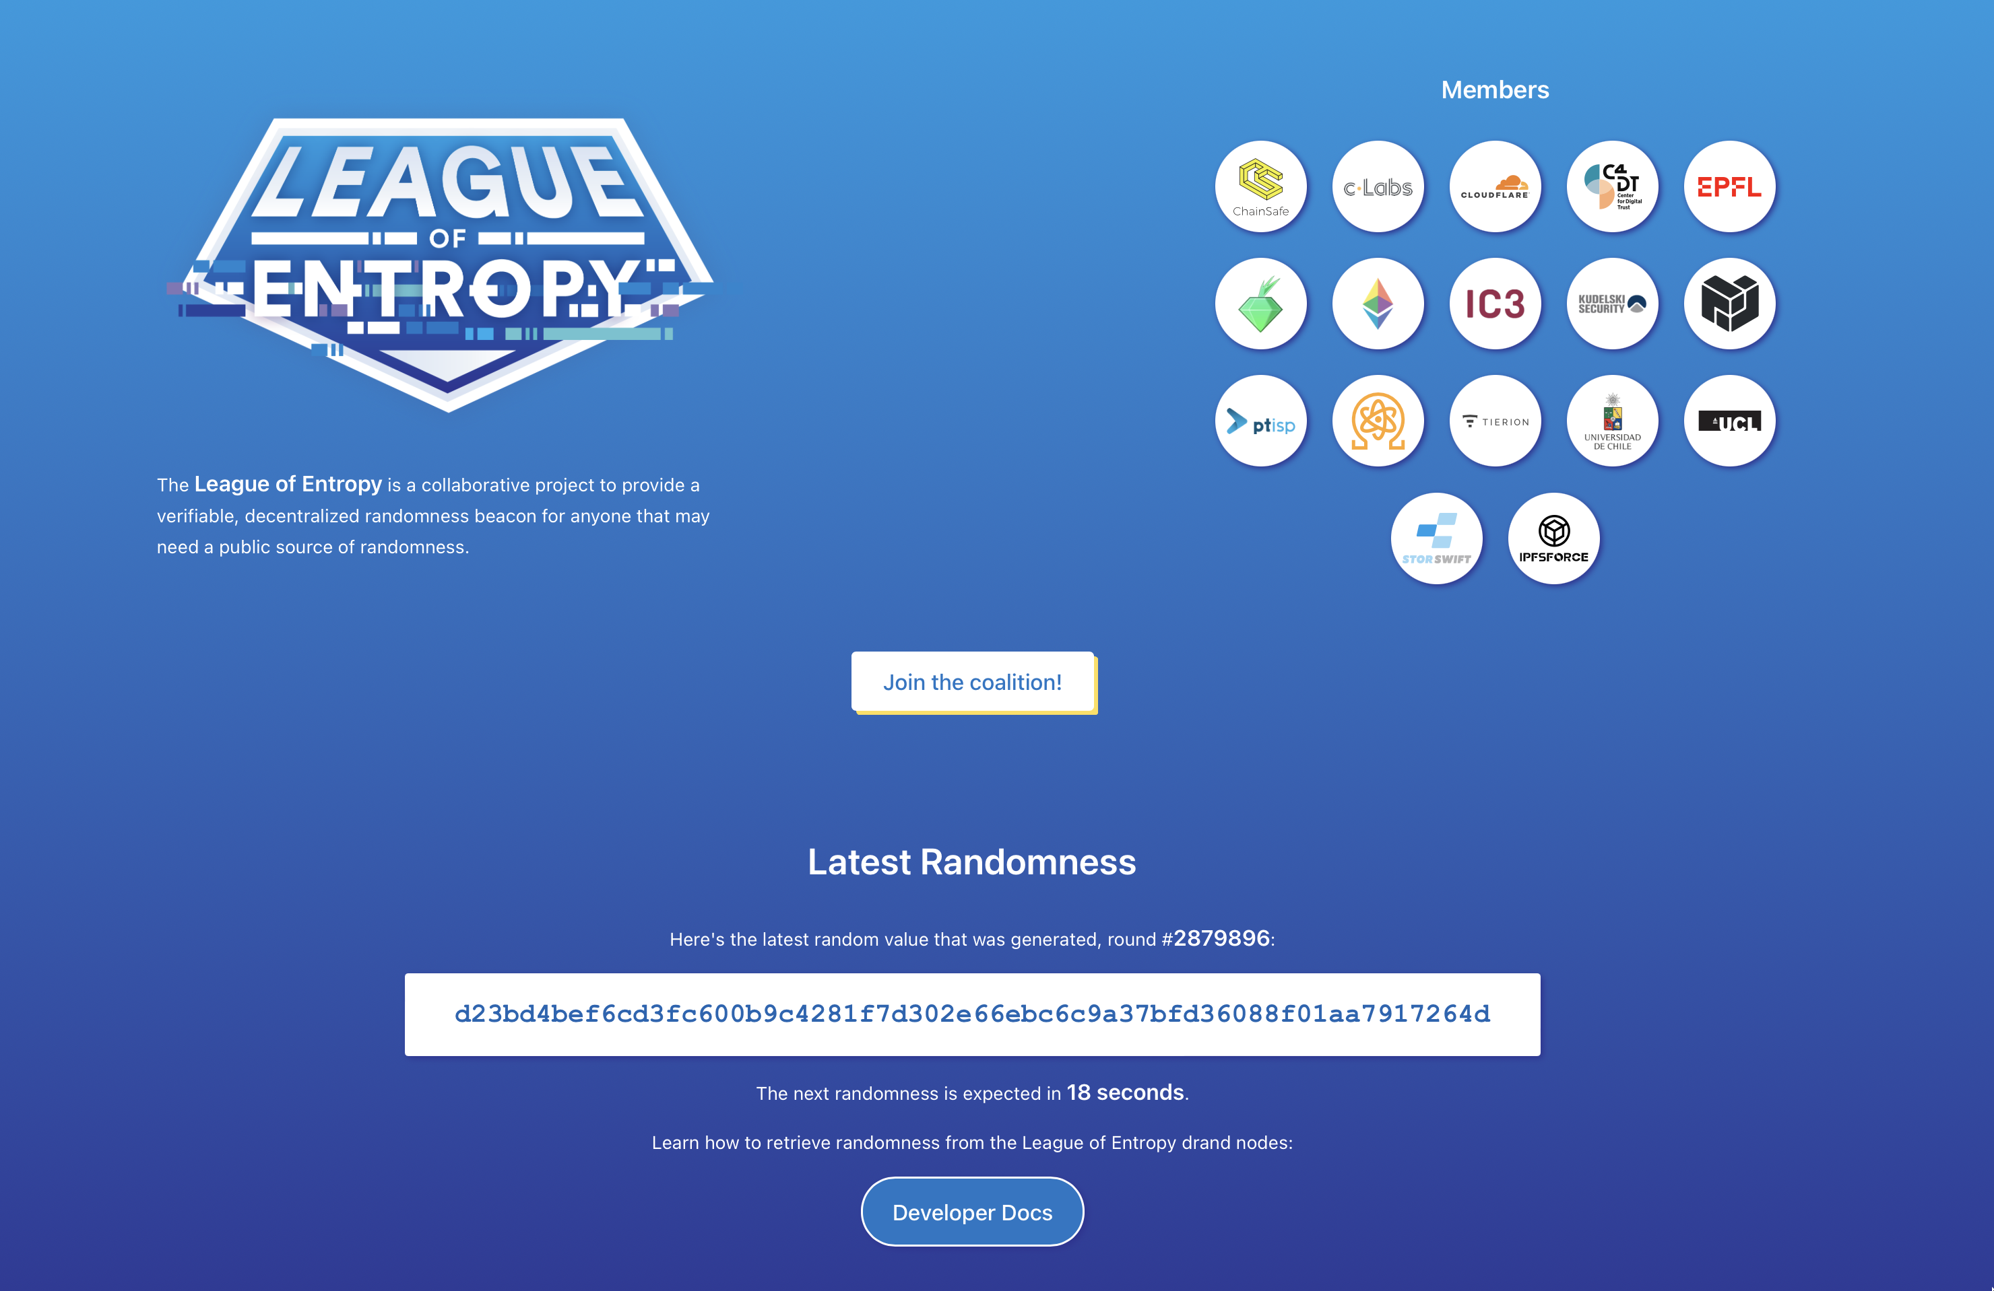
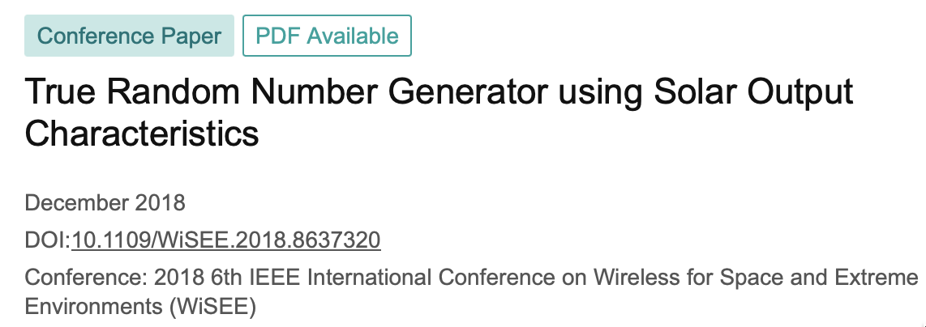
Random beacon in practice
Synchronous ($Δ=30s)$
Lock-step
Not-distributed
Not publicly verifiable

Slide 6
Context
Notation and Definitions

Slide 7
Unpredictability of random beacon protocols
A beacon protocol is said to be in round $r$, if at least one honest server is in round $r$
$d$-absolute unpredictability.
A protocol is said to be $d$-unpredictable if any adversary (including rushing) at any point in time, can predict the beacon only up to $r+d$ rounds into the future when the protocol is in round $r$
The best unpredictability is $1$-absolute unpredictability
Rushing adversaries can always compute the random beacon before the honest servers
Note: This definition of unpredictability breaks down in asynchronous networks and responsive protocols

Slide 8
Properties of random beacon protocols
Unpredictability is the property that an adversary cannot predict the distribution of random beacons
Bias-resistance is the property that an adversary cannot affect the distribution of random beacons
Both are captured together by ensuring that the output of a beacon protocol is indistinguishable from a uniformly random string
Bias Resistance
Unpredictable
No entity can influence a future random beacon away from uniform
No entity can distinguish the beacon output from a random value

Slide 9
State Machine Replication
State Machine Replication is a distributed protocol between $n$ servers and clients
It satisfies the following two properties:
Safety. All honest servers agree on the same order of client requests
Liveness. An honest client’s requests are eventually processed by the servers
In our works, we will realize SMR using hash-chains of blocks

Slide 10
Cryptographic Assumptions
Public Key Infrastructure and Digital Signatures (EU-CMA)
Random Oracles
$q−$SDH assumption
Needs a setup of $q+1$ values of the form $g$, $g^{α}$, $g^{α^{2}}$, …, $g^{α^{q}}$ to support reconfiguration up to $n^{′}=2q$ servers
This is a Structured Reference String (SRS) setup

Slide 11
Network assumptions
$Δ$-Bounded synchrony: If a node sends a message $m$ at time $t$, then its recipients must receive it by time $t+Δ$
$δ≤Δ$ denotes the actual network speed
Non-lock step: Servers can be in different rounds at different times
Their clocks are within $Δ$ of each other
Clocks have bounded skew

Slide 12
Adversary
Adversary is a PPT algorithm
Up to $t$ servers and any number of clients can be Byzantine
$f≤t$ denotes the number of actual faults (or the number of servers that are currently misbehaving)
Corruption can be static or adaptive depending on the protocol
Adversary is rushing, i.e., sees all the messages before delivering them

Slide 13
Challenges
Problems and State-of-the-art

Slide 14
Challenges
Unpredictability implies inputs from $>t$ servers
Bias-resistance implies that the random value must be in a commit-reveal format with guaranteed reveal if committed
VDFs, Verifiable Secret-sharing, threshold encryption
Reconfiguration-friendly implies
No threshold signatures or constant size quorum certificates
Synchrony implies tolerating $t<n/2$ faults (optimal)
Partial synchrony protocols do not work as they rely on $\frac{n−t}{2}>t$
Efficiency implies low communication complexity*
*Quadratic protocols are argued to be more bandwidth efficient than linear protocols

Slide 15
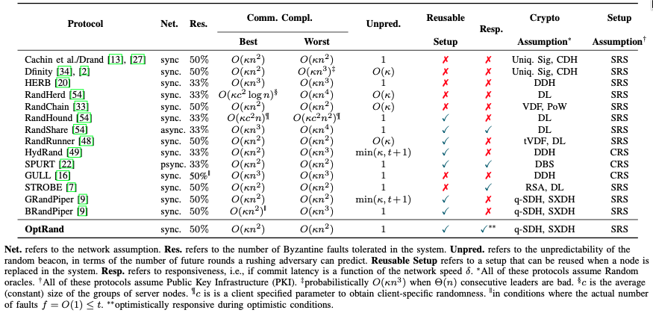
The landscape of random beacon protocols

Slide 16
State Machine Replication
An agreement engine to realize broadcast channels

Slide 17
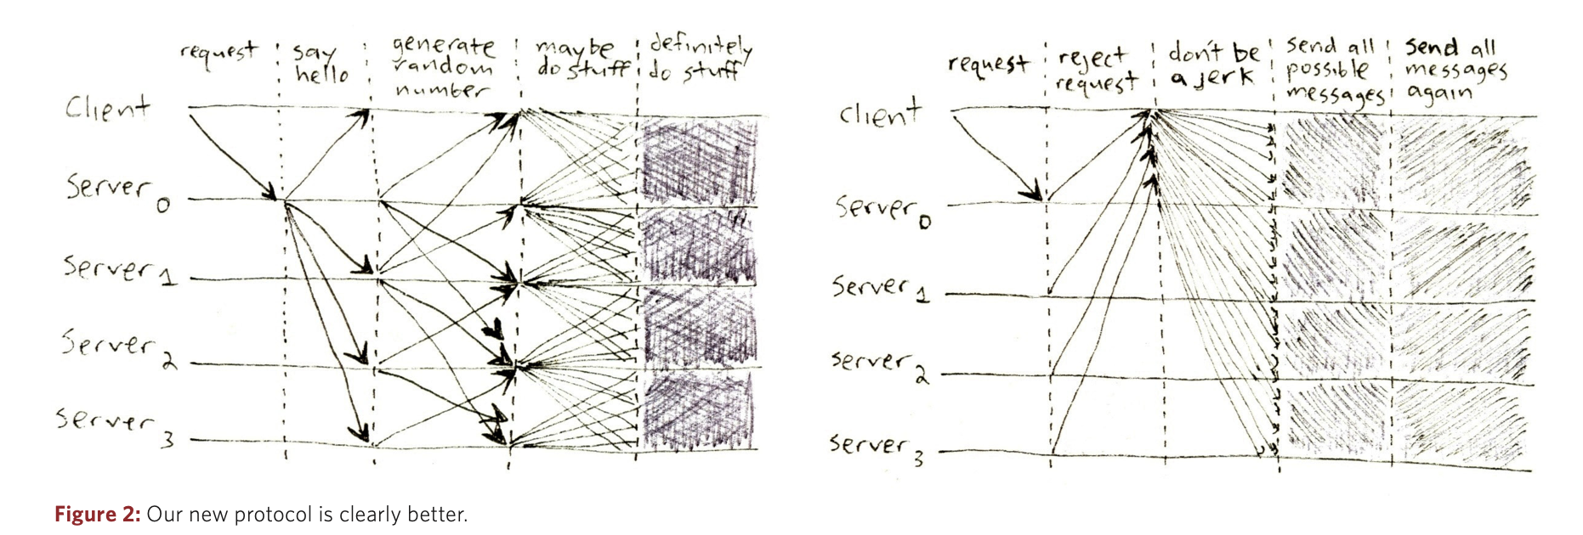
Beacon Ingredients
+
Cryptography
=
Random Beacon

Slide 18
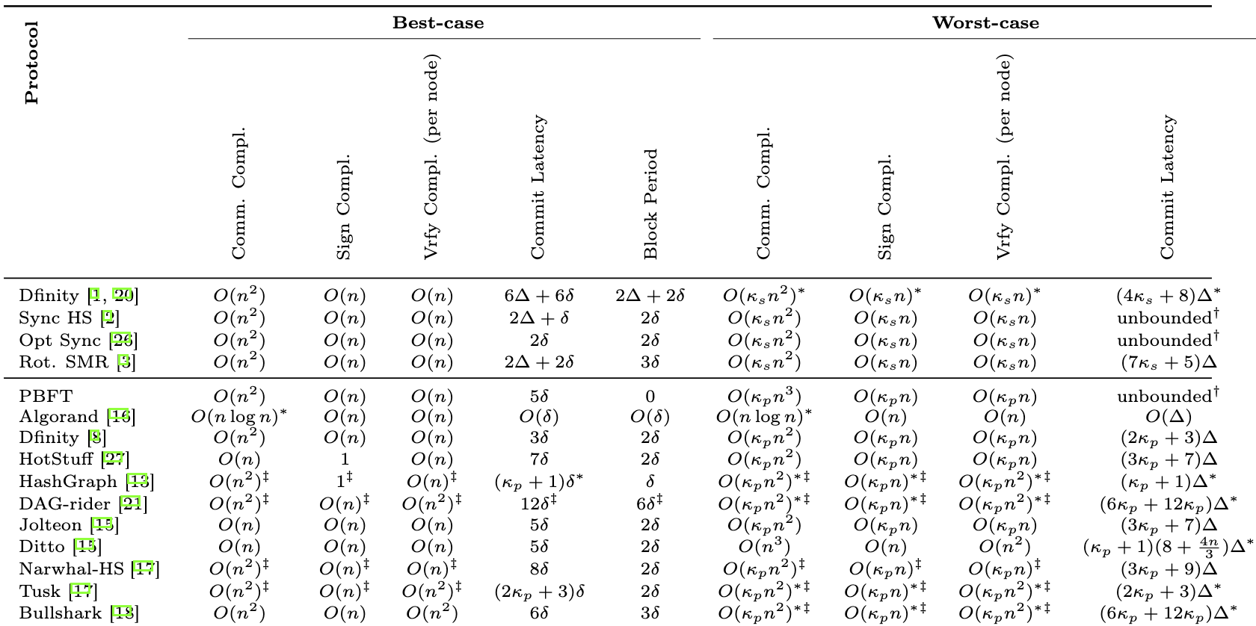
State of the art BFT-SMR
What parameters do (don’t) we care about to build a random beacon?
Notes:
- These are the SOTA for synchrony
- These are the SOTA for non-synchrony
- Most of them except PBFT have block period of at least 2\delta.
- Most of them linear digital signature computation costs.
This is because ...

Slide 19
State of the art BFT-SMR
No threshold signatures or amortized communication complexity
Notes:
- These are the SOTA for synchrony
- These are the SOTA for non-synchrony
- Most of them except PBFT have block period of at least 2\delta.
- Most of them linear digital signature computation costs.
This is because ...

Slide 20
State of the art BFT-SMR
Need new State Machine Replication Protocol
Notes:
- These are the SOTA for synchrony
- These are the SOTA for non-synchrony
- Most of them except PBFT have block period of at least 2\delta.
- Most of them linear digital signature computation costs.
This is because ...

Slide 21
Typical SMR protocols
$$r$$
$r$+1
$$r+2$$
$$1$$
$$1$$
$$1$$
Propose
Build QC for $r$
Propose
Build QC for $r+1$
…
QC = Quorum Certificate
Notes:
Each block contains a QC
The QC implies linear computation cost, and also at least one-round trip delay between two successive blocks

Slide 22
Typical SMR protocols
In $Δ−$bounded synchrony, typical protocols use equivocation detection to tolerate optimal number of faults
Equivocation detection $→$ quadratic communication
Quorum certificate $→$ linear computation
Notes:
Another thing to note is that in synchrony we use equivocation detection to improve fault-tolerance.
But,
-
-

Slide 23
Our (new) SMR protocols
Erasure code
$$r$$
$r$+1
$$r+2$$
$$1$$
$$1$$
$$1$$
Propose
Build QC for $r$
Propose
Build QC for $r+1$
…
QC = Quorum Certificate
Notes:
Each block contains a QC
The QC implies linear computation cost, and also at least one-round trip delay between two successive blocks

Slide 24
Our SMR Black boxed
We construct a round-based SMR protocol with the following properties:
In every round, the leader proposes a value of $O(n)$ size
If the leader is honest, all honest servers commit the proposed value in that round
If an honest server commits a proposal in a round, then all honest servers will eventually commit the value (in this round or in future rounds)
This is because the SMR ensures that a proposal in future rounds that does not extend such a committed block will not be accepted by any honest server
NOTE: If an honest server commits, it doesn’t know if other nodes have committed it
Requirement: leaders for rounds must be chosen consistently
SMR

Slide 25
Our SMR Black boxed
When the leader of round $r$ is honest, all honest servers will commit the value proposed by the leader and thus commit all values proposed up to round $r$
In any round $r$, we know that at least one leader in rounds $\{r−1,…, r−t−1\}$was honest
Therefore, in any round $r$, all honest servers have the same view up to round $r−t−1$
So, at the end of round $r+t$, all servers can decide whether all servers committed the proposal from the leader of round $r$ by checking if they committed a proposal from round $r$
SMR

Slide 26
Our SMR Black boxed - Features
In every round, the leader proposes a value of $O(n)$ size
The communication complexity is always $O(n^{2})$ per round
At the end of $t$ rounds, all servers agree on whether the leader of round $r$ proposed a value or not
The latency per round is $11Δ$
When $>\frac{3n}{4}$ servers behave correctly, we can ensure optimistic responsiveness, i.e., rounds progress at network speed $δ$ instead of $11Δ$ (with some help from cryptography)
SMR

Slide 27
Random Beacons
How to construct the beacons given our SMR engine?

Slide 28
Beacon Overview
3. Reconstruct $t+1$sharings to build the beacon
0xf567
2. Add the sharing for the random number to local state
0xa1e3
$t+1$ rounds
0xd5f33
or
0x986e
SMR
2. Remove server from the system. (No longer eligible to be a leader)
0x0000
1. Servers add verifiable sharings of random numbers in their turn as a leader

Slide 29
GRandPiper
Synchronous, always quadratic random beacon
RandPiper – Reconfiguration Friendly Random Beacons with Quadratic Communication. CCS 2021. Adithya Bhat, Nibesh Shrestha, Aniket Kate, Kartik Nayak.

Slide 30
GRandPiper
Always $O(n^{2})$ communication complexity per beacon
$min(κ,t)+1$ –absolute unpredictability
Uses Publicly Verifiable Secret Sharing (PVSS)
The leaders are chosen using the generated randomness without repetition for $t$ rounds
Notes:
GRandPiper has a commmunication complexity of O(n^2) per beacon. Let's take a look at how we achieve this.

Slide 31
GRandPiper
1
2
3
4
5
1
$$s_{1}$$
$$s_{2}$$
$$s_{3}$$
$$s_{4}$$
$$s_{5}$$
$$s_{1}′$$
$$s_{1}$$
$$s_{2}$$
$$s_{3}$$
$$s_{4}$$
or
or
or
or
$$⊥$$
$$⊥$$
$$⊥$$
$$⊥$$
*Assume round-robin leader-scheduling for now
PVSS Sharing
PVSS Reconstruction
^{[CD’17]}
Notes:
Consider a round robin sequence of servers from 1 to 5 looping back to 1.
Server 1 in round 1 shares s1 using PVSS and our SMR.
Next server 2 in round 2 shares s2 using PVSS and the SMR.
Similarly, all the servers share random numbers using PVSS and our SMR.
At the end of t+1 rounds, we will either commit s1 or commit nothing.
At the end of the t+2nd round, we will again either commit s2 or commit nothing.
The same principle applies to all the proposals.
Now, at the end of round t+1, observe that server 1’s proposal is either accepted by all the servers or all the servers know that server 1 did not propose anything. In general, before a server becomes a leader again, we always commit some block from that server or all the server know that it did not propose anything.

Slide 32
GRandPiper
2
1
2
3
4
5
1
$$s_{1}$$
$$s_{2}$$
$$s_{3}$$
$$s_{4}$$
$$s_{5}$$
$$s_{1}′$$
Using this technique, we can ensure that the leader of every round has a previously proposed secret
$$s_{1}$$
$$s_{2}$$
$$s_{3}$$
$$s_{4}$$
OR
OR
OR
OR
$$⊥$$
$$⊥$$
$$⊥$$
$$⊥$$
PVSS Sharing
^{[CD’17]}
PVSS Reconstruction
Notes:
In our beacon protocol, we will remove servers that do not propose anything. In this example, server 1 is removed, and server 2 becomes a leader in round n+1.
This allows us to have a sequence of leaders for whom we will always have some PVSS shares.

Slide 33
GRandPiper
1
2
3
4
5
1
$$s_{1}$$
$$s_{2}$$
$$s_{3}$$
$$s_{4}$$
$$s_{5}$$
$$s_{1}′$$
Sequence of previous values
$$s_{1}$$
$$s_{2}$$
$$s_{3}$$
$$s_{4}$$
$$s_{5}$$
$$s_{1}′$$
$$O_{1}= H(s_{1},s_{2},s_{3})$$
$$O_{2}= H(s_{4},O_{1})$$
$$O_{3}= H(s_{5},O_{2})$$
$$O_{4}= H(s_{1}′,O_{3})$$
PVSS Sharing
^{[CD’17]}
PVSS Reconstruction
Notes:
Now, let’s see how we build our beacons in parallel to the SMR protocol. Consider the same sequence of servers and their previously committed PVSS values.
In round 1-n, server 1 shared s1.
All the servers reconstruct s1 in round 1.
Similarly, in round 2-n, server 2 shared s2
Which we reconstruct in round n+2.
The same principle is applied to every server.
To build the first beacon O1 in round t+1, we hash the first t+1 random numbers. Since we are using t+1 numbers s1…st+1 one of which is uniformly random, guaranteeing that the beacon is also uniformly random.
The next beacon O2 is simply the hash of the secret of the current server s4 and the previous beacon O1.
We repeat this for every round.
Observe that, an adversary that does does not know honest server’s values, say server 4’s value, cannot predict any of the values after round n+4. The beacons after round n+4, need s4 directly or indirectly to compute the future beacons. Therefore, an adversary cannot indefinitely predict values into the future.

Slide 34
GRandPiper
Reduce predictability advantage from $t+1$ to $\min\left(κ, t\right)+1$ by choosing leaders randomly based on the beacons
Limitations
a Byzantine leader can learn random value $(11κ+2)Δ$ before other honest nodes
an adaptive adversary can learn random beacons t+1 rounds before* other honest servers
$κ$ – security parameter
*Ignoring the fact that we do not know any adaptively secure PVSS
Notes:
The GRandPiper protocol we have described so far uses round robin to choose the leaders for a round. This gives an adversary the power to predict t+1 values into the future. To solve this, we also randomize the leaders using our beacons without replacing the leader until t rounds. This reduces the predictability advantage to O(min(k,t+1)) where k is the ... For details please refer to our paper.
The limitations of GRandPiper are:
In a round, if the next leader is Byzantine, the adversary gets to know the beacon 13\Delta before the other honest servers.
This problems gets worse if you assume an adaptive adversary corrupting the next t servers.

Slide 35
BRandPiper
Synchronous, always unpredictable random beacon
RandPiper – Reconfiguration Friendly Random Beacons with Quadratic Communication. CCS 2021. Adithya Bhat, Nibesh Shrestha, Aniket Kate, Kartik Nayak.

Slide 36
BRandPiper
Round 1
Round 2
Round …
$$r_{1,1}$$
$$r_{1,2}$$
…
$$r_{1,n}$$
$$r_{2,1}$$
$$r_{2,2}$$
…
$$r_{2,n}$$
$$…$$
$$…$$
…
$$…$$
Beacon(r) = $H(R_{r})$
$$r_{n,1}$$
$$r_{n,2}$$
…
$$r_{n,n}$$
+
$$R_{1}$$
$$R_{2}$$
$$R_{3}$$
$$R_{4}$$
VSS Sharing
^{[KZG’10]}
VSS Reconstruction
Notes:
On a high level, In this approach, in every round,
say round 1,
we will take random number shares from all the servers,
combine them homomorphically
to build the random number R1,
whose hash is the beacon for that round. Since R1 has contributions from all the honest servers, it must be random.
Similarly, we repeat this for every round.

Slide 37
BRandPiper
$$r_{1,1}$$
$$r_{1,2}$$
…
$$r_{1,n}$$
$$r_{1,1}$$
$$r_{1,2}$$
…
$$r_{1,n}$$
$$r_{2,1}$$
$$r_{2,2}$$
…
$$r_{2,n}$$
$$r_{2,1}$$
$$r_{2,2}$$
…
$$r_{2,n}$$
…
$$r_{.,1}$$
$$r_{.,2}$$
…
$$r_{.,n}$$
SMR
$$r_{n,1}$$
$$r_{n,2}$$
…
$$r_{n,n}$$
$$r_{n,1}$$
$$r_{n,2}$$
…
$$r_{n,n}$$
VSS Sharing
VSS Reconstruction
Notes:
In every round, since we are now consuming O(n) random numbers,
we also need to add O(n) random numbers.
So the servers add secret sharings for n random numbers in every round. For example, server 1 adds r11 r12 and so on up to r1n
in its turn to propose,
which gets committed and after n rounds, we have enough shares from everyone to build our beacon.

Slide 38
BRandPiper
How to share $O\left(n\right)$ secrets from different servers without always incurring $O(n^{3})$ communication complexity?
Not possible with current PVSS/SMR constructions
😮‍💨 Use our new iVSS to get a communication complexity of $O(fn^{2})$ to share $O(n)$ VSS secrets
Notes:
Now the million dollar or bitcoin question is: How do we share O(n) secrets without incurring O(n^3) comm. Complexity always?
It turns out that if you use PVSS to share O(n) secrets, then the input information is O(n^2) and we can’t do better than O(n^3).
Fortunately, it turns that there is hope if you use VSS. We come up with iVSS or improved VSS which allows us to share O(n) secrets using O(fn^2) comm complexity where f is the number of actual faults in the system.

Slide 39
A message posted on the bulletin board is seen by all the servers instantly.
Traditional VSS (eVSS)
Send shares privately
Commitment to ($r_{1,1}$)
Commitment to ($r_{1,2}$)
Commitment to ($r_{1,..,}$)
Commitment to ($r_{1,n}$)
Comm. Complexity of $O(fn)$ on the broadcast channel
Complaint from 2
Complaint from 4
Shares for server 2 of ($r_{1,1}, r_{1, 2}, …, r_{1,n}$)
Shares for server 4 of ($r_{1,1}, r_{1, 2}, …, r_{1,n}$)
Notes:
Consider the classical VSS protocols such as eVSS in the bulletin board world. The bulletin board abstraction allows all the servers to see the same message instantly even if the sender of the message is Byzantine.
The protocols consist of a dealer and the other servers
and a bulletin board.
The dealer posts the commitments to all the n random numbers on the bulletin board.
The dealer also privately sends everyone their shares for these commitments.
Servers that do not receive any share post a complaint on the bulletin board.
For every complaint on the bulletin board, the dealer posts their shares publicly thereby denying the allegation that it was faulty.
If all the complaints are resolved with correct shares, then all servers finish the sharing protocol.
This protocol requires a communication complexity of O(fn) on the bulletin board. It turns out that we can do something better that does not involve so many posts on the bulletin board.

Slide 40
improved VSS (iVSS)
Send shares privately
Commitment to ($r_{1,1}$)
Commitment to ($r_{1,2}$)
Commitment to ($r_{1,..,}$)
Commitment to ($r_{1,n}$)
Send a signed vote message to the dealer if all blames are resolved by the leader
Certificate from $>n/2$ servers
Comm. Complexity of $O(n)$ on the broadcast channel, and the vote certificate can be integrated into the SMR
Send Blames among each other and ask the leader to provide the shares for every received blame.
Notes:
We develop an improvement over the classical VSS protocols called iVSS.
We have the same setup as before.
The dealer still sends its shares privately to all the servers.
This time we will not be posting the complaints on the bulletin board. If a server does not receive a share it will tell all the other servers that it did not receive a share. Every server collects such complaints and asks the leader for shares corresponding to every complaint. This is identical to the classical VSS protocol in terms of the information revealed except that we don’t agree on the set of people blaming. If a server sees that a leader correctly resolves all the complaints it received, then it sends a vote message to the leader.
The leader posts a vote certificate on the bulletin board thereby finishing the protocol.
The communication complexity of this approach is O(n). An added benefit of this approach is that the vote certificate in the final step can be integrated into the SMR’s votes. Since our SMR also uses certificates, we can re-use the same certificate for iVSS.

Slide 41
BRandPiper
$1$-absolute unpredictable
An adaptive adversary only has an advantage of $2Δ$ at any time
Best-case communication complexity is amortized $O(n^{2})$ when $f=O(1)$
Worst-case communication complexity is $O(n^{3})$

Slide 42
OptRand
Synchronous, always unpredictable random beacon
OptRand - Optimistically Responsive Reconfigurable Distributed Randomness.NDSS 2023. Adithya Bhat, Nibesh Shrestha, Aniket Kate, Kartik Nayak.

Slide 43
OptRand
Can we design a $1−$unpredictable random beacon?
Not possible with current adaptively secure secret-sharing techniques
😮‍💨 Use our new PVSS with decomposition proofs to prove that a PVSS has inputs from $t+1$ servers and input that to our SMR protocol
With this new cryptographic technique, we can now make our SMR optimistically responsive
This helps us build the first threshold-signature free rotating leader SMR protocol
x2
Notes:
Now the million dollar or bitcoin question is: How do we share O(n) secrets without incurring O(n^3) comm. Complexity always?
It turns out that if you use PVSS to share O(n) secrets, then the input information is O(n^2) and we can’t do better than O(n^3).
Fortunately, it turns that there is hope if you use VSS. We come up with iVSS or improved VSS which allows us to share O(n) secrets using O(fn^2) comm complexity where f is the number of actual faults in the system.

Slide 44
Publicly Verifiable Secret Sharing (PVSS)
General PVSS Structure
Encryption for node 1
…
Encryption for node $n$
$O\left(1\right)$ size
Commitment to $\left(n,t\right)$ polynomial
The proof guarantees that
The degree of the polynomial in the commitment portion of the PVSS is $t$
The encryptions correspond to the committed polynomial
$O\left(n\right)$ size
Proof that everyone’s shares are correct
Output of PVSS Share generation

Slide 45
Publicly Verifiable Secret Sharing (PVSS)
General PVSS Structure
Encryption for node 1
…
Encryption for node $n$
is homomorphic
Commitment to $\left(n,t\right)$ polynomial
not homomorphic
Proof that everyone’s shares are correct
Problem: If $O(t)$ sharings are combined, the resulting PVSS is $O\left(nt\right)$ sized
Output of PVSS Share generation

Slide 46
Publicly Verifiable Secret Sharing (PVSS)
Using Pairing based PVSS from SCRAPE^{[CD19]}
Encryption for node 1
…
Encryption for node $n$
is homomorphic
Commitment to $\left(n,t\right)$ polynomial
Problem: An adversarial combiner can cancel honest server’s shares of $r$ by generating shares of $−r$ and thus fix the final secret
We need a mechanism to prevent adversary from forging honest server’s shares
$⊥$ (Proof using pairings)
Output of Pairing-based PVSS Share generation

Slide 47
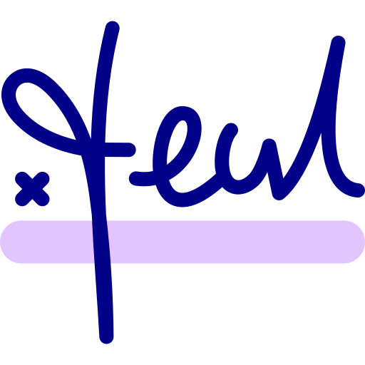
Publicly Verifiable Secret Sharing (PVSS)
Solution: Add decomposition proofs that contain
A NIZK proof that the node creating the sharing knows the secret in the PVSS
Authentication information (e.g., digital signature)
NIZK – Non-Interactive Zero Knowledge

Slide 48
Publicly Verifiable Random Sharing
Leader
PVRS: The size is $O(n)$

Slide 49
Publicly Verifiable Random Sharing
Leader
In this example, anyone can verify that
All nodes (1, 2, …, 5) have contributed to this PVRS
It is an $\left(n,t\right)$ sharing
The shares for all the nodes are correct
BONUS: If the nodes reconstruct the secret S, then anyone can verify that $S$ is the correct reconstruction using $O(1)$ information
Broadcast Channel or SMR

Slide 50
Technique Overview
PVSS
(3) Leader aggregates $t+1$ PVSS into a Publicly Verifiable Random Sharing
0xf567
0xa1e3
(2) Nodes generate random values shared via a homomorphic Publicly Verifiable Secret Sharing (PVSS)
0xd5f33
0x1111
Leader
SMR
(4) The rotating leader-based SMR handles
invalid/no inputs
Low-latency and low-communication complexity agreement
Beacon generation using reconstruction of PVRS
0x0000
(1) We have $t<n/2$ Byzantine nodes in the system
indicates PVSS
Notes:
Now, I will give an overview of the techniques used in OptRand.

Slide 51
OptRand
$1$-absolute unpredictable
An adaptive adversary only has an advantage of $2Δ$ at any time
Communication complexity is always $O(n^{2})$
Limitations:
Not known to be adaptively secure

Slide 52
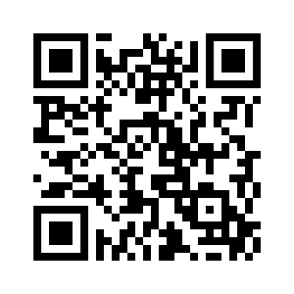
Conclusion and Open problems
Random beacons in the presence of BQROM or Random oracles in quantum Constantinople?
Information-theoretic random beacons
Adaptively secure optimal efficient random beacons
My webpage
THANK YOU!

